Slide 1

Diabetes Chat Bot
Megan Holford
Summer 2022

Slide 2
Is creating a chatbot helpful for businesses and users?
Can help streamline the experience of finding information for users.
For a business, a chat bot can help with customer engagement, labor costs and more.
For users, can be helpful if they need need help navigating, or to help route them to where they need to be for assistance.

Slide 3
Data and Methods
For the information used for the chat bot, I used information from the Mayo Clinic, here: https://www.mayoclinic.org/diseases-conditions/diabetes/symptoms-causes/syc-20371444
For the text model, I used NLTK and SKLearn packages to use the information from the webpage to create a chat bot that users can interact with.

Slide 4
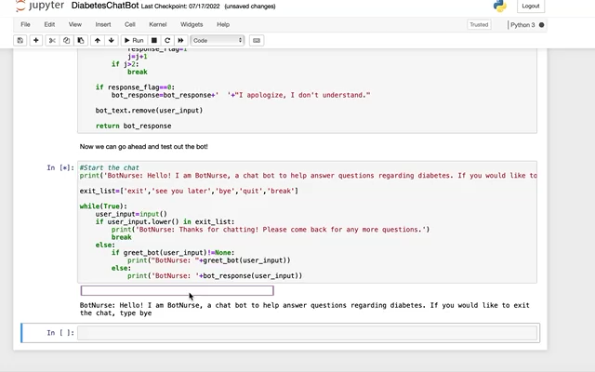

Slide 5
Conclusions and Ethics
There is a use for chat bots in businesses and organizations.
When it comes to ethical implications, making sure that your users know they are interacting with a chat bot is importation as well as making sure your chat bot is providing them with correct information.

